Slide 1
IEEE TRANSACTIONS ON COMMUNICATIONS, VOL. 68, NO. 3, MARCH 2020
Deep Reinforcement Learning for 5G Networks:
Joint Beamforming, Power Control, and
Interference Coordination

Slide 2
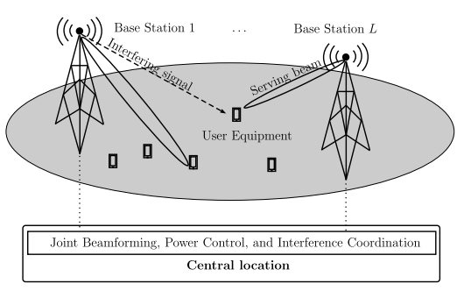
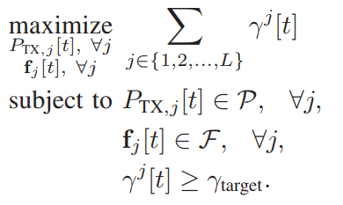
Contributions
수신 SINR을 최적화하는 문제로 다운 링크 방향으로 joint beamforming, power control, and interference coordination 문제를 공식화
central location에서 수신 SINR과 UE의 좌표만 uplink방향으로 전송하여 기지국 간의 race condition을 해결
한 번에 여러 작업을 수행 할 수 있는 deep reinforcement learning 기반 솔루션을 만드는 방법을 보여줌

Slide 3

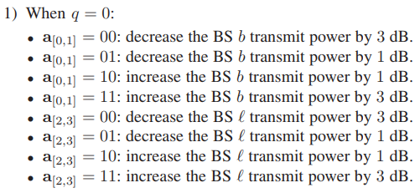
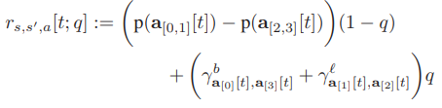

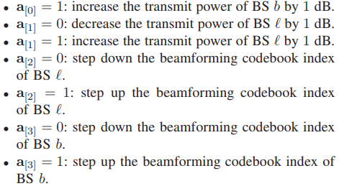
x_ue_1, y_ue_1, x_ue_2, y_ue_2, pt_serving, pt_interferer, f_n_bs1, f_n_bs2 = state
Data
x_ue_1, y_ue_1, x_ue_2, y_ue_2, pt_serving, pt_interferer = state
Voice
P = [-3, -1, 1, 3]
IC = (action & 0b1100) >> 2 PC = (action & 0b0011) IC = P[IC] PC = P[PC] pt_serving *= 10**(PC/10.) pt_interferer *= 10**(IC/10.)
Voice
Data
reward = received_sinr + received_ue2_sinr
power_command_l = action & 0b0001 # 1 power up, 0 power down power_command_b = (action & 0b0010) >> 1 # 1 power up, 0 power down bf_selection_l = (action & 0b0100) >> 2 # 1 step up, 0 step down bf_selection_b = (action & 0b1000) >> 3
reward = P[PC] - P[IC]
Voice
if (power_command_l == 0): pt_serving *= 10**(-1/10.) else: pt_serving *= 10**(1/10.) if (power_command_b == 0): pt_interferer *= 10**(-1/10.) else: pt_interferer *= 10**(1/10.) if (bf_selection_l == 1): f_n_bs1 = (f_n_bs1 + 1) % self.k_oversample*self.M_ULA else: f_n_bs1 = (f_n_bs1 - 1) % self.k_oversample*self.M_ULA if (bf_selection_b == 1): f_n_bs2 = (f_n_bs2 + 1) % self.k_oversample*self.M_ULA else: f_n_bs2 = (f_n_bs2 - 1) % self.k_oversample*self.M_ULA
Data
self.F = np.zeros([self.M_ULA, self.k_oversample*self.M_ULA], dtype=complex)

Slide 4
reward = received_sinr + received_ue2_sinr
Data
reward = P[PC] - P[IC]
Voice
For voice bearers, we reward the agent more if it chooses to power control the serving BS $b$ than if it chooses to control the interference from the other BS $l$.
done = (pt_serving <= self.max_tx_power) and (pt_serving >= 0) and (pt_interferer <= self.max_tx_power_interference) and (pt_interferer >= 0) and \ (received_sinr >= self.min_sinr) and (received_ue2_sinr >= self.min_sinr) and (received_sinr >= self.sinr_target) and (received_ue2_sinr >= self.sinr_target) abort = (pt_serving > self.max_tx_power) or (pt_interferer > self.max_tx_power_interference) or (received_sinr < self.min_sinr) or (received_ue2_sinr < self.min_sinr) \ or (received_sinr > 70) or (received_ue2_sinr > 70)
if abort == True: done = False reward = self.reward_min elif done: reward += self.reward_max

Slide 5
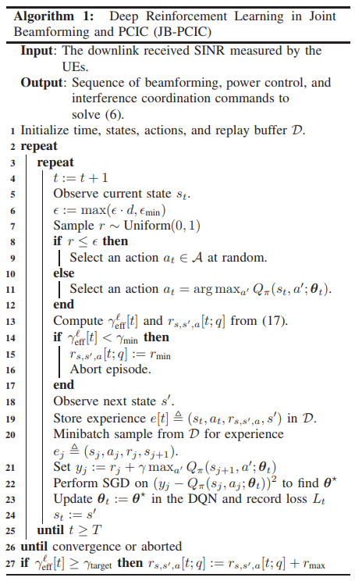
for timestep_index in 1 + np.arange(max_timesteps_per_episode): # Take a step next_observation, reward, done, abort = env.step(action)
action = agent.act(observation)
act_values = self.model.predict(state) return np.argmax(act_values[0]
received_sinr = self._compute_rf(x_ue_1, y_ue_1, pt_serving, pt_interferer, is_ue_2=False) received_ue2_sinr = self._compute_rf(x_ue_2, y_ue_2, pt_serving, pt_interferer, is_ue_2=True)
reward = received_sinr + received_ue2_sinr
reward = P[PC] - P[IC]
done = (pt_serving <= self.max_tx_power) and (pt_serving >= 0) and (pt_interferer <= self.max_tx_power_interference) and (pt_interferer >= 0) and \ (received_sinr >= self.min_sinr) and (received_ue2_sinr >= self.min_sinr) and (received_sinr >= self.sinr_target) and (received_ue2_sinr >= self.sinr_target) abort = (pt_serving > self.max_tx_power) or (pt_interferer > self.max_tx_power_interference) or (received_sinr < self.min_sinr) or (received_ue2_sinr < self.min_sinr) \ or (received_sinr > 70) or (received_ue2_sinr > 70)
if abort == True: done = False reward = self.reward_min elif done: reward += self.reward_max
if abort == True: print('ABORTED.') break

Slide 6
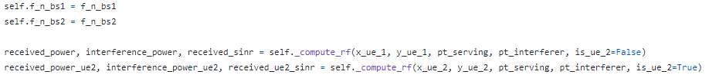

# Remember the previous state, action, reward, and done agent.remember(observation, action, reward, next_observation, done) # Sample replay batch from memory sample_size = min(len(agent.memory), batch_size) # Learn control policy loss, q = agent.replay(sample_size)
def remember(self, state, action, reward, next_state, done): self.memory.append((state, action, reward, next_state, done)) # Make sure we restrict memory size to specified limit if len(self.memory) > 2000: self.memory.pop(0)
def replay(self, batch_size): minibatch = random.sample(self.memory, batch_size) X, y = self._construct_training_set(minibatch) with tf.device('/gpu:0'): loss = self.model.train_on_batch(X, y) _q = np.mean(y) return loss, _q

Slide 7
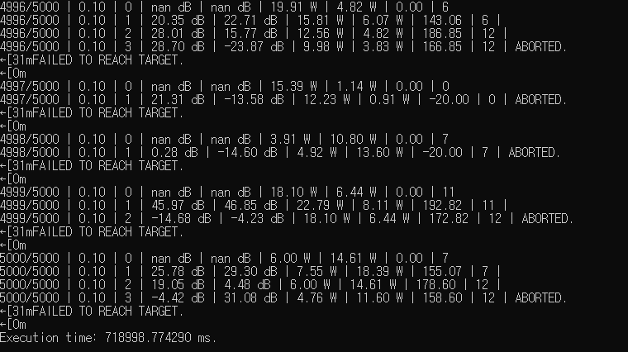
print('{}/{} | {:.2f} | {} | {:.2f} dB | {:.2f} dB | {:.2f} W | {:.2f} W | {:.2f} | {} | '.format(episode_index, max_episodes_to_run, agent.exploration_rate, timestep_index, received_sinr, received_ue2_sinr, pt_serving, pt_interferer, total_reward, action), end='')

